Slide 1
Asymmetric-Key Cryptography
Dr. B C Dhara
Department of Information Technology
Jadavpur University

Slide 2
Objectives
Distinguish between two cryptosystems: symmetric-key and asymmetric-key
Introduce trapdoor one-way functions and their use in asymmetric-key cryptosystems
Introduce the knapsack cryptosystem as one of the first ideas in asymmetric-key cryptography
Discuss on
  RSA cryptosystem, Rabin cryptosystem, ElGamal cryptosystem and Elliptic curve cryptosystem
B C Dhara, Dept. of IT, JU

Slide 3
Introduction
Symmetric and asymmetric-key cryptography will exist in parallel and continue to serve the community
People believe that they are complements of each other
  the advantages of one can compensate for the disadvantages of the other
Symmetric-key cryptography is based on sharing secrecy;
asymmetric-key cryptography is based on personal secrecy.
In a community of n people
symmetric-key cryptography needed n(n-1)/2 secrets
asymmetric-key cryptography needed n secrets
B C Dhara, Dept. of IT, JU

Slide 4
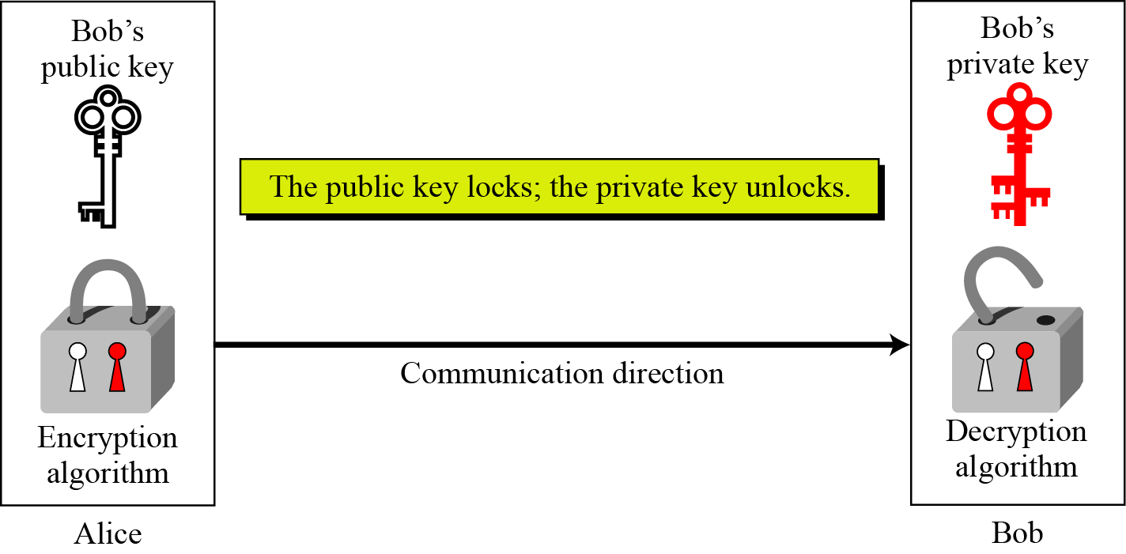
Keys
Asymmetric key cryptography uses two separate keys: one private and one public
B C Dhara, Dept. of IT, JU

Slide 5
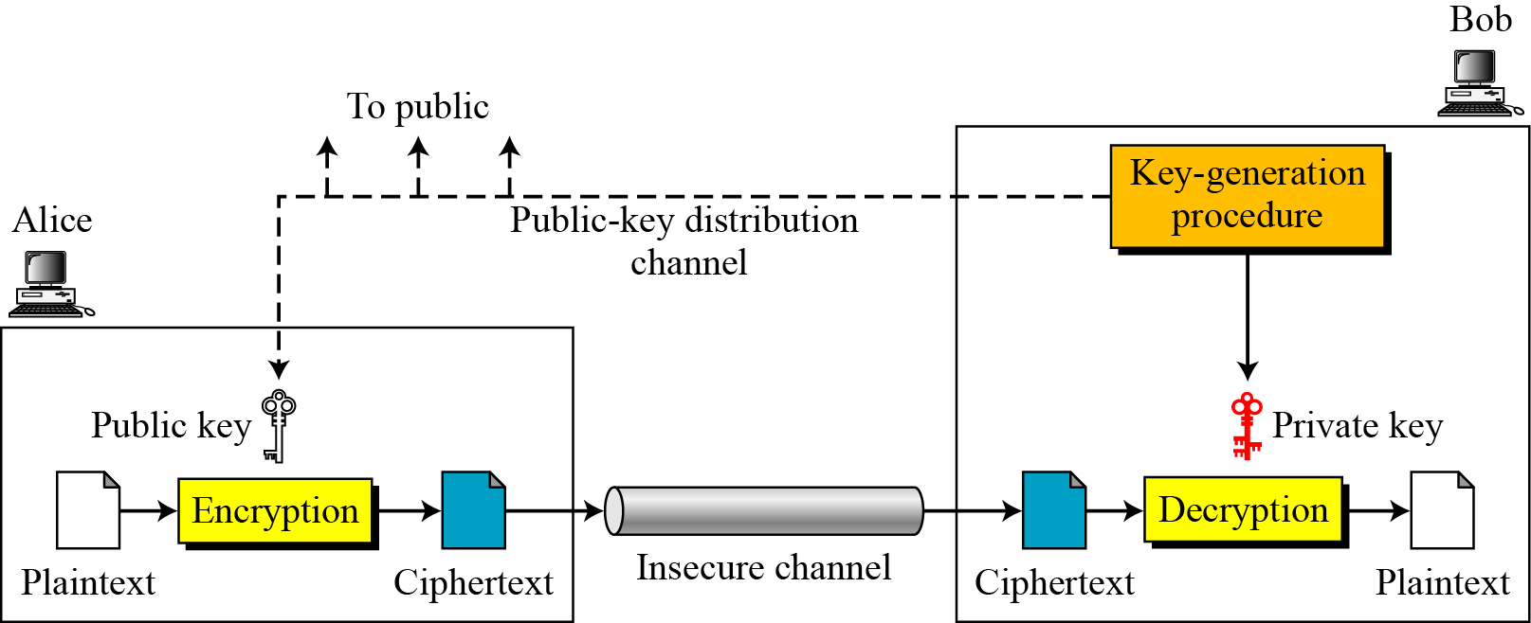
General idea of asymmetric-key cryptosystem
Sender and receiver cannot use same set of keys for two-way communication
B C Dhara, Dept. of IT, JU

Slide 6
General idea of asymmetric-key cryptosystem (contd…)
In symmetric-key cryptography plaintext and ciphertext are symbols which are either permuted or substituted
In asymmetric- key cryptography plaintext and ciphertext are numbers, which are manipulated by mathematical functions
C = f (K_{public} , P) P = g(K_{private} , C)
B C Dhara, Dept. of IT, JU

Slide 7
Need for Both cryptography
There is a very important fact that is sometimes misunderstood: the advent of asymmetric-key cryptography does not eliminate the need for symmetric-key cryptography
Asymmetric-key cryptography uses mathematical functions for both encryption and decryption
  much slower than symmetric-key cryptography
  for large message, symmetric-key cryptography is needed
  Asymmetric-key cryptography is needed for authentication, digital signature, and secret-key exchange
People believe that they are complements of each other
B C Dhara, Dept. of IT, JU

Slide 8
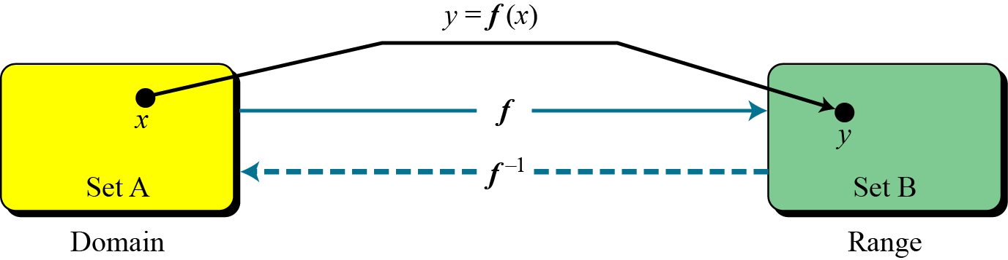
Trapdoor One-Way Function
The main idea behind asymmetric-key cryptography is the concept of the trapdoor one-way function
Function:
B C Dhara, Dept. of IT, JU

Slide 9
Trapdoor One-Way Function
One-Way Function (OWF)
  f is easy to compute
  f ⁻¹ is difficult to compute
Trapdoor One-Way Function (TOWF)
  f is easy to compute
  f ⁻¹ is difficult to compute
  Given y and a trapdoor, x can be computed easily
B C Dhara, Dept. of IT, JU

Slide 10
Example
When n is large, n = p × q is a one-way function
Given p and q , it is always easy to calculate n
given n, it is very difficult to compute p and q
This is the factorization problem
When n is large, y = x^{k} mod n is a trapdoor one-way function
Given x, k, and n, it is easy to calculate y
Given y, k, and n, it is very difficult to calculate x
This is the discrete logarithm problem
if we know the trapdoor, k′ such that k × k ′ = 1 mod n, we can use x = y^{k′} mod n to find x
B C Dhara, Dept. of IT, JU

Slide 11
Knapsack Cryptosystem
This Cryptosystem is insecure with today’s standard
  The main idea behind this cryptosystem gives an insight into recent public-key cryptosystems
Definition
a = [a₁, a₂, …, a_{k} ] and x = [x₁, x₂, …, x_{k}].
Given a and x, it is easy to calculate s. However, given s and a it is difficult to find x.
B C Dhara, Dept. of IT, JU

Slide 12
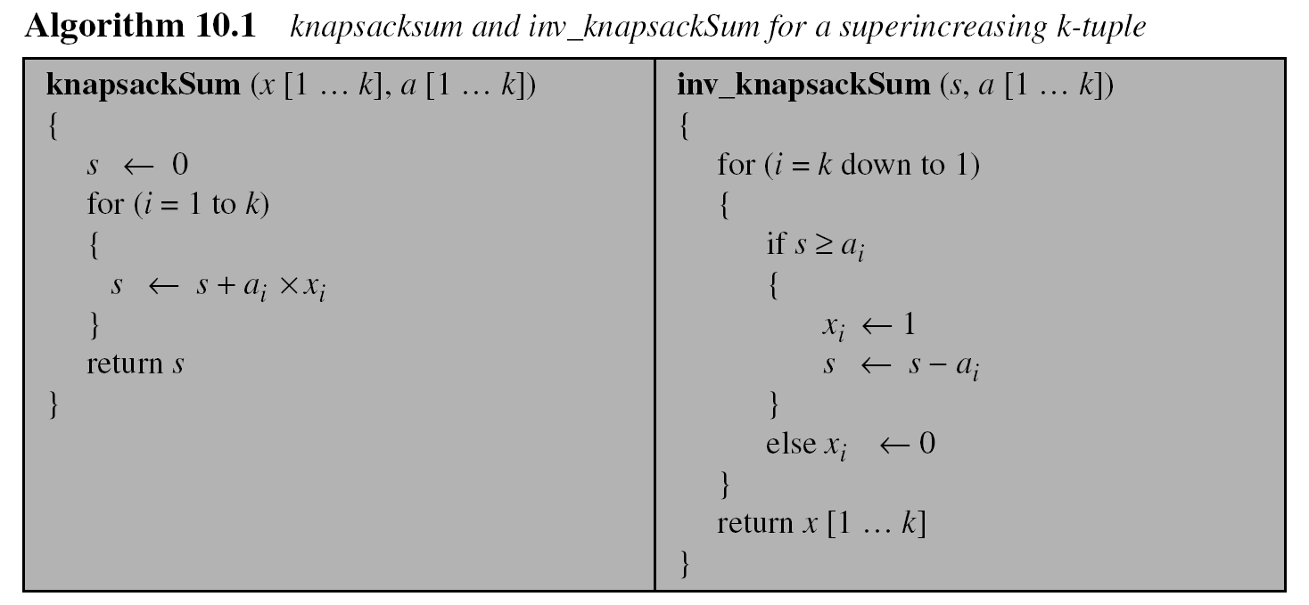
Knapsack Cryptosystem (contd…)
Finding solution of knapsack is easy if ‘a’ is superincreasing ,i.e.,
a_{i} ≥ a₁ + a₂ + … + a_{i−1}
B C Dhara, Dept. of IT, JU

Slide 13
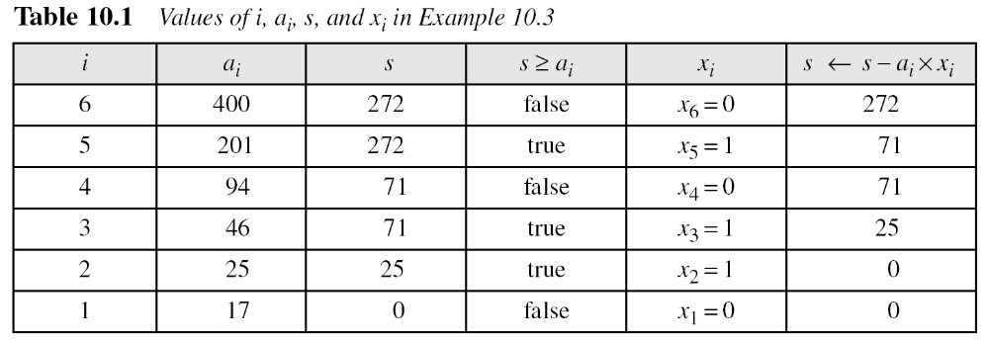
Knapsack Cryptosystem (contd…)
Assume that a = [17, 25, 46, 94, 201, 400] and s = 272 are given.
Table 10.1 shows how the tuple x is found using inv_knapsackSum routine in Algorithm 10.1. In this case x = [0, 1, 1, 0, 1, 0], which means that 25, 46, and 201 are in the knapsack.
B C Dhara, Dept. of IT, JU

Slide 14

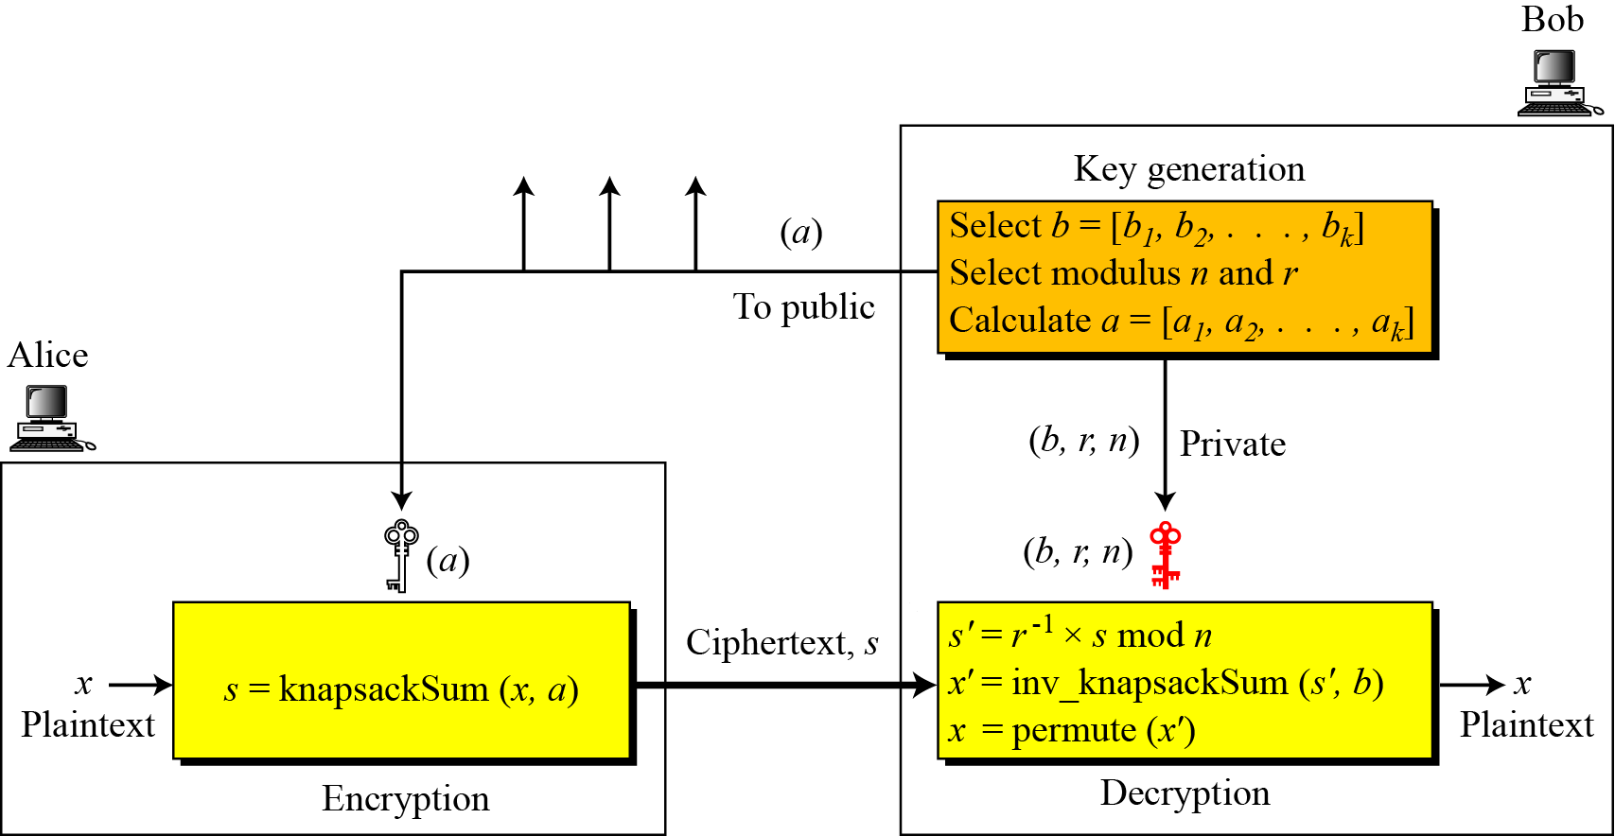
Secret Communication with Knapsacks
Key Generation:
Consider superincreasing k-tuple b=[b₁, b₂,…, b_{k}]
Select n , n> b₁+ b₂+…+b_{k}
Select a random integer r, relatively prime to n and 1 ≤ r <n
Compute k-tuple t= [t₁, t₂,…, t_{k}], b_{i} = r × b_{i},…mod n
a=permute(t)
Public-key: a ; private-key: n, r, b, permute
Encryption:
Convert message to k-tuple x=[x₁, x₂,…, x_{k}], x_{i} ∈ {0, 1}
s=knapsackSum(a, x)
Decryption:
s’= r⁻¹× s mod n
x’=inv_knapsackSum(s’, b)
x=permute(x’)
B C Dhara, Dept. of IT, JU

Slide 15
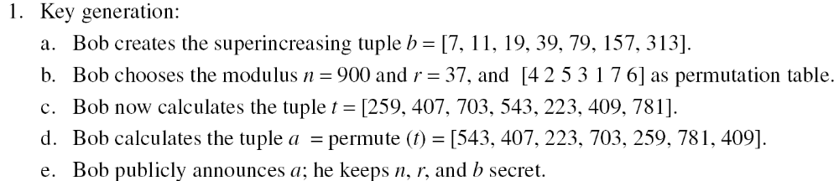
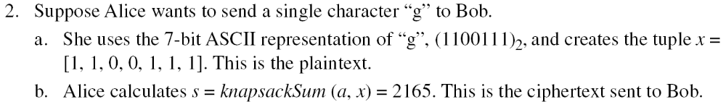
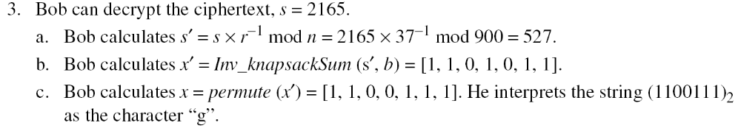
Example
Key Generation:
Consider superincreasing k-tuple b=[b₁, b₂,…, b_{k}]
Select n , n> b₁+ b₂+…+b_{k}
Select a random integer r, relatively prime to n and 1 ≤ r <n
Compute k-tuple t= [t₁, t₂,…, t_{k}], b_{i} = r × b_{i},…mod n
a=permute(t)
Public-key: a ; private-key: n, r, b
Encryption:
Convert message to k-tuple x=[x₁, x₂,…, x_{k}], x_{i} ∈ {0, 1}
s=knapsackSum(a, x)
Decryption:
s’= r⁻¹× s mod n
x’=inv_knapsackSum(s’, b)
x=permute(x’)
B C Dhara, Dept. of IT, JU

Slide 16
RSA Cryptosystem
The most common public-key algorithm is the RSA cryptosystem, named for its inventors (Rivest, Shamir, and Adleman)
RSA uses two exponent: e and d
  e is public and d is private
  Encryption: C= P^{e} mod n
  Decryption: P=C^{d} mod n
  n is very large, created during key generation
Both encryption and decryption uses modular exponent
B C Dhara, Dept. of IT, JU

Slide 17
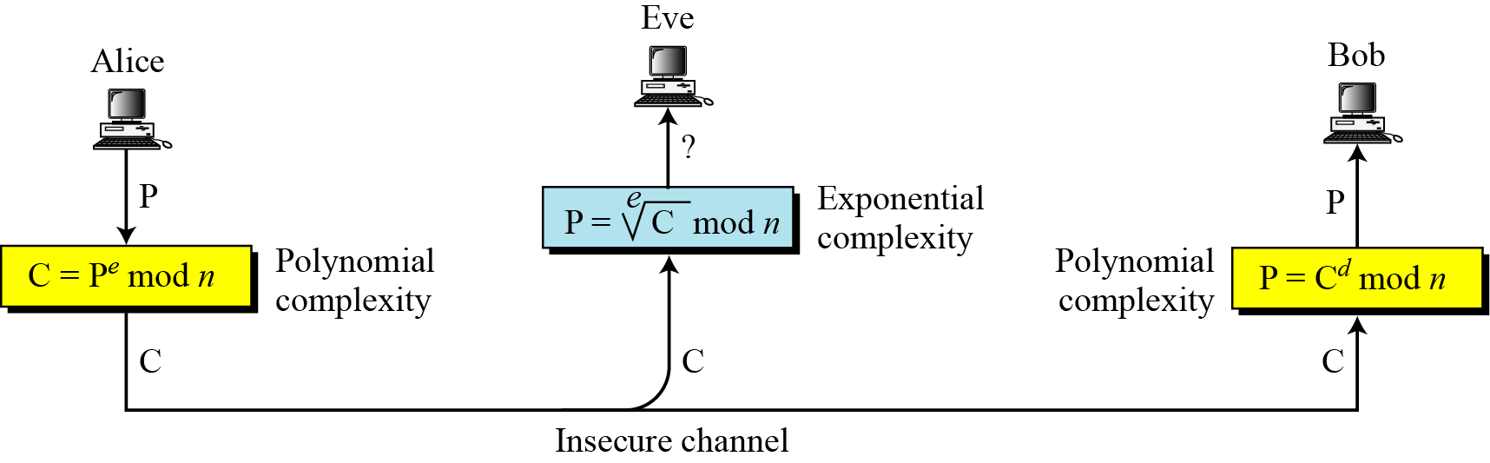
RSA Cryptosystem (contd…)
Modular exponent is polynomial time
Modular logarithm is as hard as modulus factoring
B C Dhara, Dept. of IT, JU

Slide 18
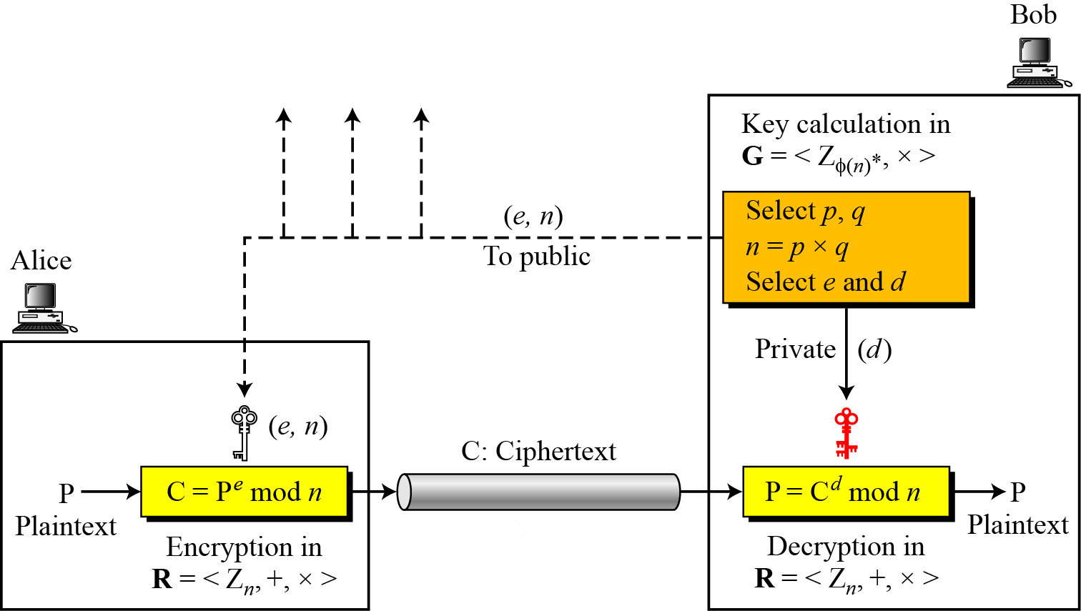
Procedure of RSA
Key is generated in multiplicative group G = <Z_{φ(n)}∗, × > (private group)
Encryption/decryption are done in commutative ring R = <Z_{n}∗, +,× > (public)
B C Dhara, Dept. of IT, JU
(e, n) is public and d is private

Slide 19
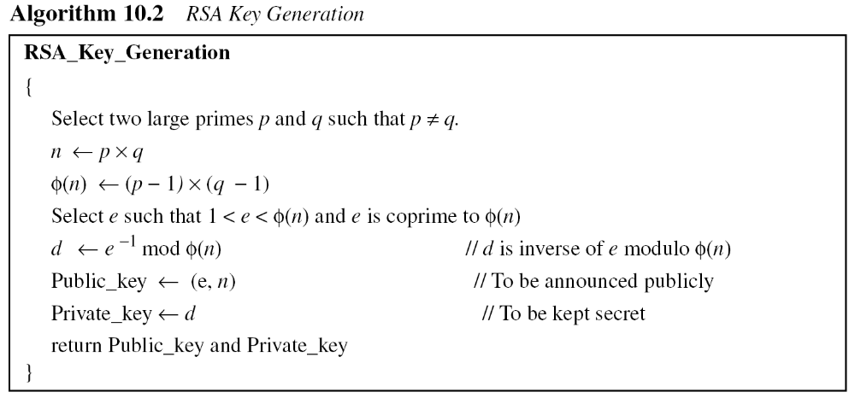
Key generation
// Discard p and q and φ(n)
B C Dhara, Dept. of IT, JU

Slide 20
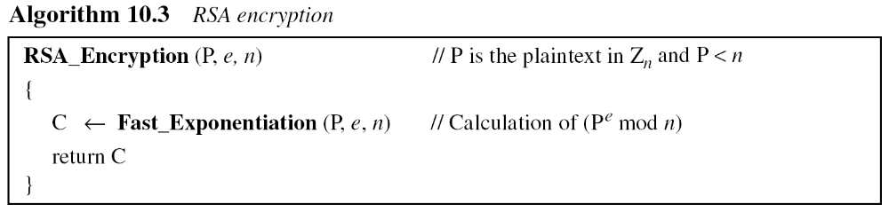
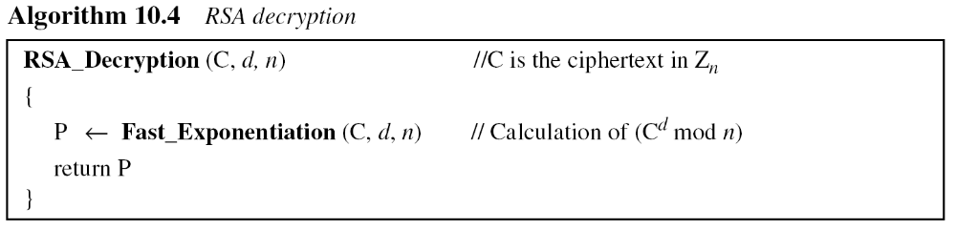
RSA encryption/decryption
B C Dhara, Dept. of IT, JU

Slide 21
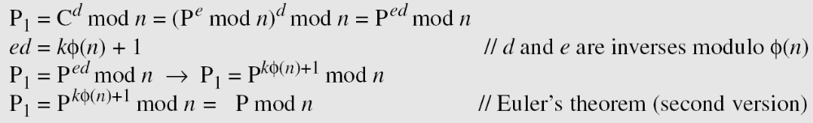
RSA encryption/decryption (contd…)
B C Dhara, Dept. of IT, JU

Slide 22
RSA cryptosystem: example1
Bob chooses 7 and 11 as p and q and calculates n = 77. The value of φ(n) = (7 − 1)(11 − 1) or 60
Select e and d, from Z₆₀∗, e × d mod 60 = 1 (e=13 and d=37 are inverses of each)
Plaintext is 5, e=13 then
The ciphertext is 26 and the private key 37 to decipher the ciphertext as:
B C Dhara, Dept. of IT, JU

Slide 23
RSA cryptosystem: example2
For another plaintext 63 with the same key e=13, the ciphertext will be
For ciphertext 28 with private key 37, the plaintext is
B C Dhara, Dept. of IT, JU

Slide 24
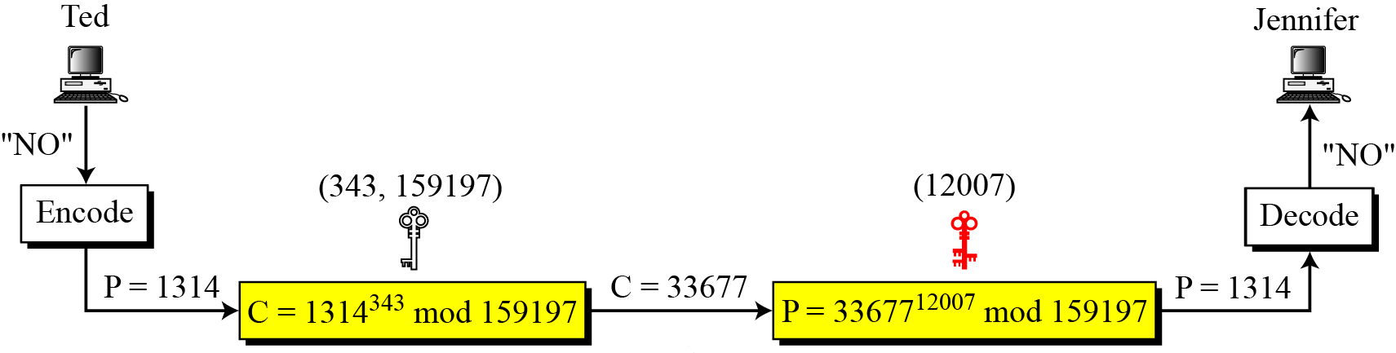
RSA cryptosystem: example3
For p = 397 and q = 401, n = 159197
φ(n) = 158400; say, e = 343 then d = 12007
Suppose, message is “NO” to transmit
Change each character to a number (from 00 to 25), with each character coded as two digits
Then concatenates the two coded characters and gets a four-digit number
The plaintext is 1314
B C Dhara, Dept. of IT, JU

Slide 25
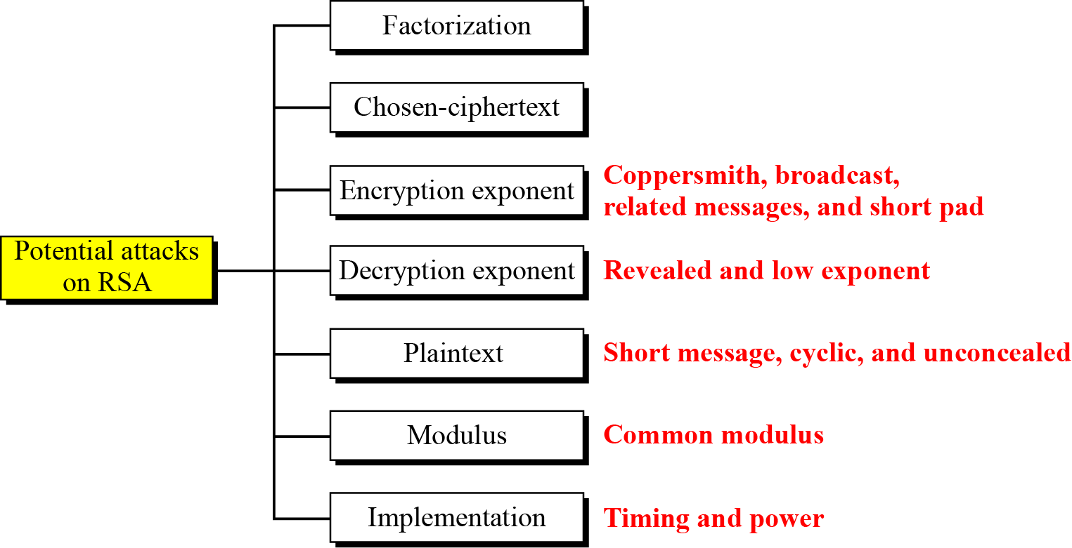
Attacks on RSA
No devastating attacks on RSA have been discovered yet
B C Dhara, Dept. of IT, JU

Slide 26
Factorization attack on RSA
Factoring n (n=p*q) is infeasible in reasonable time
If n can be factored, then φ(n) = (p-1)*(q-1) can be computed, d = e⁻¹ mod φ(n) can be calculated
None of the factorization algorithm can factored a large number in polynomial time
If n is number having more than 300 digits (i.e., more than 1024 bits)
  It takes infeasible long time
RSA is secure as long as no efficient factorization algorithm is designed
B C Dhara, Dept. of IT, JU

Slide 27
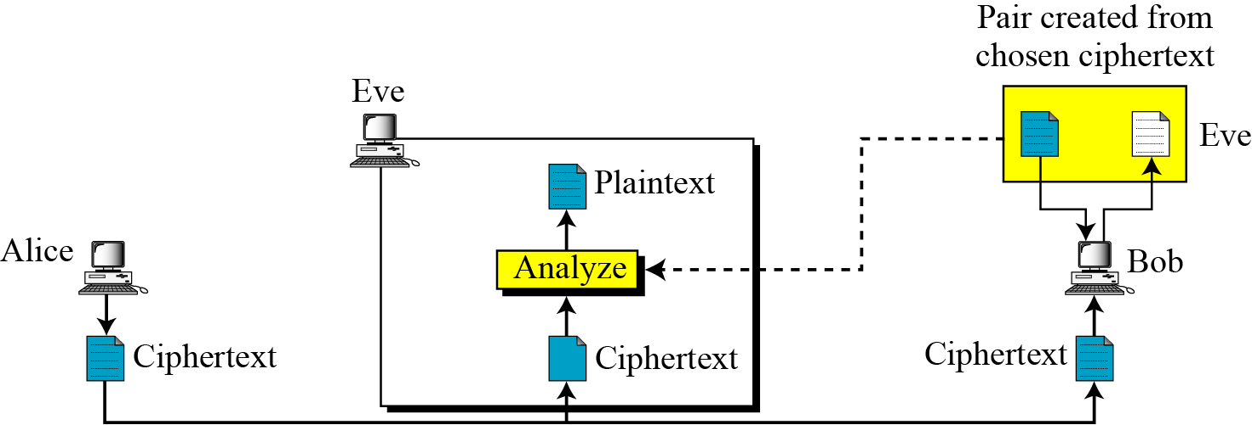
Chosen-ciphertext attack
B C Dhara, Dept. of IT, JU

Slide 28
Chosen-ciphertext attack
Sender creates C= P^{e} mod n and send to receiver
Attacker:
  Choose a random number X ∈ Z_{n}*
  Compute Y = C × Xe mod n
  Y sends to receiver (i.e., attacker also have access machine of the receiver), i.e., Z=Y^{d} mod n
  Attacker find P
  Z=Y^{d} mod n = (C × Xe )^{d} mod n= (C^{d} × X^{ed} ) mod n = (P × X) mod n
  P = Z× X⁻¹ mod n
B C Dhara, Dept. of IT, JU

Slide 29
Attacks on the encryption exponent
Small exponent value e is vulnerable
  Normally used value 3 (second prime)
  Recommended value of e to use is 2¹⁶+1 =65537 (or a prime number close to this)
Broadcast attacks:
  Same message is sends to a group of recipients with same low exponent
  C₁= P³ mod n₁ C₂= P³ mod n₂ and C₃= P³ mod n₃
  Chinese remainder theorem: C’= P³ mod n₁n₂n₃ and P³< n₁n₂n₃
  P = C’^{1/3}
B C Dhara, Dept. of IT, JU

Slide 30
Short pad attack
C₁= Enc(M | r1, e, n) not reached to recipient
C₂= Enc(M | r2, e, n)
Attacker intercepts both C1 and C2 and drop
  Since, both C1 and C2 are from same message and r1 and r2 are short, then original message can be easily recovered by the attacker
B C Dhara, Dept. of IT, JU

Slide 31
Attacks on decryption exponent
If d is compromised, then p, q, n, e and d must be regenerated
The recommendation is to have d ≥ 1/3 n^{¼} to prevent low decryption exponent attack
B C Dhara, Dept. of IT, JU

Slide 32
Plaintext attacks
Plaintext and ciphertext in RSA are permutation of each other
  This allow some attacks on the plaintext
  Short message attack, cycling attack and unconcealed attack
Short message attack
  Set of possible plaintexts in known to attacker
    Additional information, ciphertext is permutation of plaintext
    Exhaustive search
    Message be padded with random bits (at front end and the end) before encryption using a method called OAEP
B C Dhara, Dept. of IT, JU

Slide 33
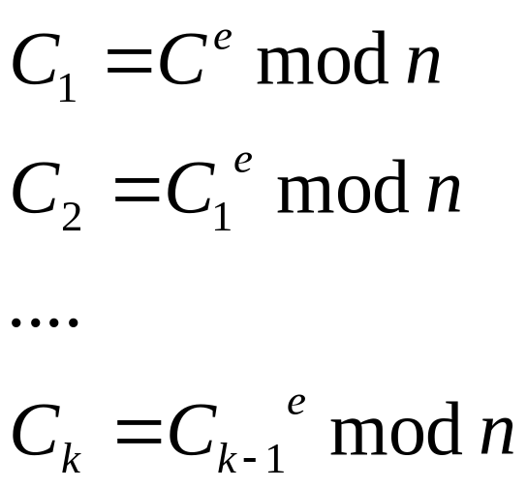
Cycling attack
Ciphertext is permutation of plaintext
  Continuous encryption of the ciphertext will result the plaintext
  If C_{k} = C, then P=C_{k-1}
B C Dhara, Dept. of IT, JU

Slide 34
Unconcealed message attack
If C== P
  In exponent, for P=0 or P=1, C=P
  We have more for some particular exponent
  The encryption program, checks the ciphertext and if its same as plaintext
    Reject that plaintext
B C Dhara, Dept. of IT, JU

Slide 35
Attacks on implementatio
So far, we consider attacks on underlying structure of RSA
Now, attacks on the implementation of RSA:
  Timing attack, and
  Power attack
B C Dhara, Dept. of IT, JU

Slide 36
Timing attack
In RSA, exponent is used
  Exponent (definitely odd number) can be computed by square and multiplication method
    If the corresponding bit value of exponent is 0 ➔ square
    If the corresponding bit value of exponent is 1 ➔ both square and multiplication
      Bit 1 ➔ more execution time
      Bit 0 ➔ less execution time
B C Dhara, Dept. of IT, JU

Slide 37
Power attack
Similar to timing attack
Measures the power consumption
B C Dhara, Dept. of IT, JU

Slide 38
Recommendations for RSA
Number of bits for n should be1024, i.e., 309 decimal digits
Two prime numbers should be at least 512 bits, i.e., 154 decimal digits
Values of p and q should not be very close to each other
p and q should have least one large prime factor
The value of e should be close to 2¹⁶+1
Message must be padded using OAEP
B C Dhara, Dept. of IT, JU

Slide 39
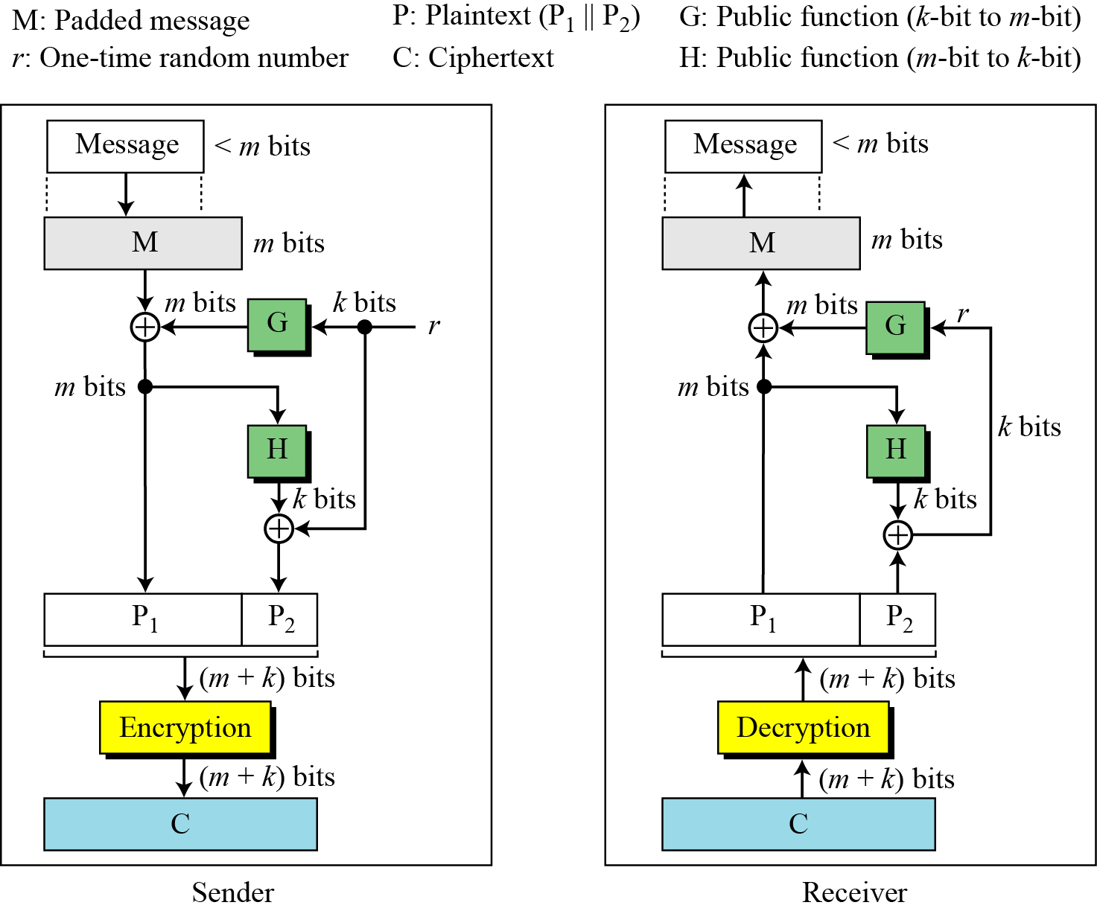
OAEP (optimal asymmetric encryption padding)
A short message in RSA makes the ciphertext vulnerable to short message attack
  Adding some bogus data (padding) makes the attack harder
  The recommended procedure is OAEP (optimal asymmetric encryption padding)
Error in transmission of ciphertext, recovery of plaintext is not possible
B C Dhara, Dept. of IT, JU

Slide 40
RABIN CRYPTOSYSTEM
The Rabin cryptosystem can be thought of as an RSA cryptosystem in which the value of e and d are fixed.
RSA is based on exponentiation congruence
Rabin is based on quadratic congruence
The encryption is C ≡ P² (mod n) and the decryption is P ≡ C^{1/2} (mod n).
B C Dhara, Dept. of IT, JU

Slide 41
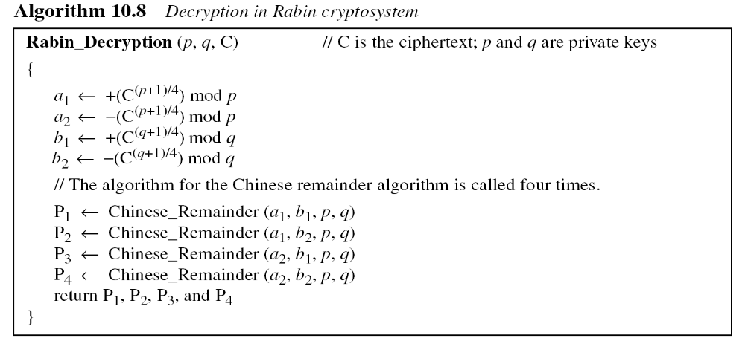
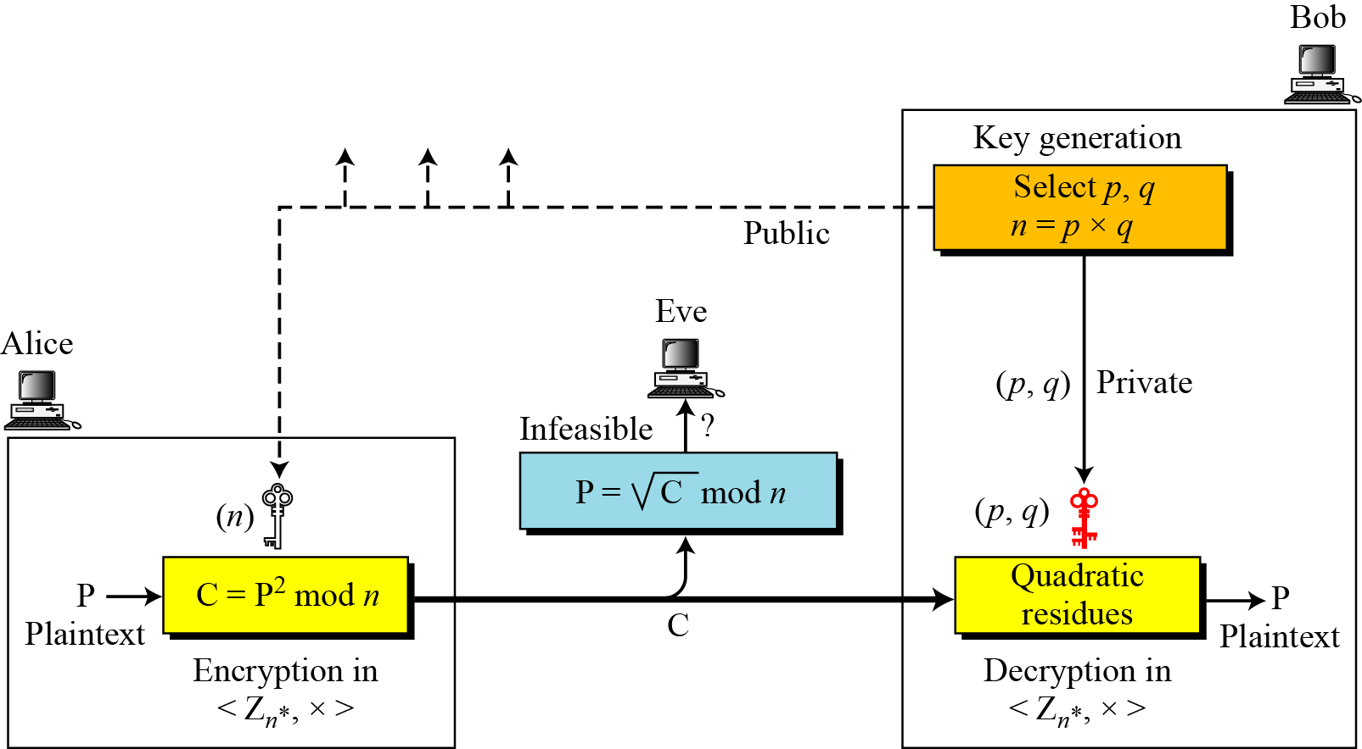
RABIN CRYPTOSYSTEM (contd…)
p and q are prime of the form 4k+3 to make decryption process easier
The Rabin cryptosystem is not deterministic: Decryption creates four plaintexts.
B C Dhara, Dept. of IT, JU

Slide 42
Example: Rabin crypto system
Bob selects p = 23 and q = 7, both are congruent to 3 mod 4.
Bob calculates n = p × q = 161.
Alice wants to send the plaintext P = 24, 161 and 24 are relatively prime; 24 is in Z₁₆₁*. She calculates C = 24² = 93 mod 161, and sends the ciphertext 93 to Bob.
Bob receives 93 and calculates four values:
a₁ = +(93 ^{(23+1)/4}) mod 23 = 1 mod 23
a₂ = −(93 ^{(23+1)/4}) mod 23 = 22 mod 23
b₁ = +(93 ^{(7+1)/4}) mod 7 = 4 mod 7
b₂ = −(93 ^{(7+1)/4}) mod 7 = 3 mod 7
Bob takes four possible answers, (a₁, b₁), (a₁, b₂), (a₂, b₁), and (a₂, b₂), and uses the Chinese remainder theorem to find four possible plaintexts: 116, 24, 137, and 45.
116² ≡ 93 mod 161, 24² ≡ 93 mod 161, 137² ≡ 93 mod 161, 45² ≡ 93 mod 161
Note that only the second answer is Alice’s plaintext.
B C Dhara, Dept. of IT, JU

Slide 43
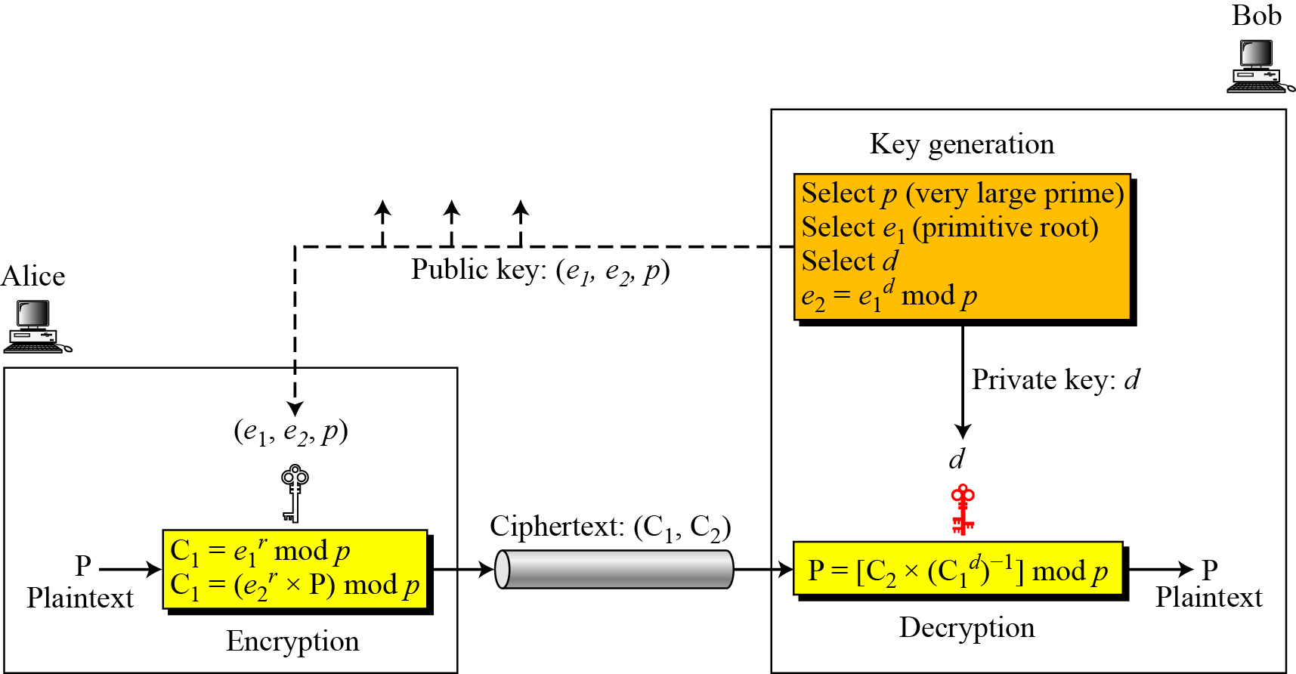
ELGAMAL CRYPTOSYSTEM
Besides RSA and Rabin, another public-key cryptosystem is ElGamal, based on the discrete logarithm problem
d ∈ G=<Z_{p}*,×>, 1≤d≤p-2
e₁ primitive root . in G=<Z_{p}*,×>
C₁^{d} = (e₁^{r})^d= e₁rd = e₁^{dr} = (e₁^{d} )^r = e₂^{r}
C₁ = e₁^{r} mod p
C₂ = (e₂^{r} × P) mod p
B C Dhara, Dept. of IT, JU

Slide 44
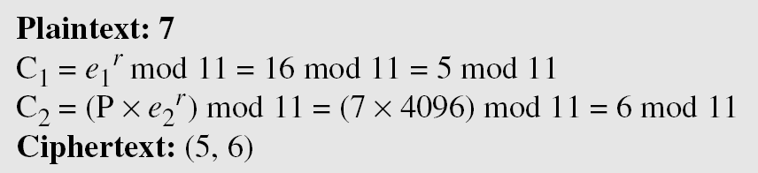
Example: ElGamal cryptosystem
Here is a trivial example. Bob chooses p = 11 and e₁ = 2.
and d = 3 e₂ = e₁^{d} = 8. So the public keys are (2, 8, 11) and the private key is 3. Alice chooses r = 4 and calculates C1 and C2 for the plaintext 7.
Instead of using P = [C₂ × (C₁^{d}) ⁻¹] mod p for decryption, we can avoid the calculation of multiplicative inverse and use
P = [C₂ × C₁ ^{p−1−d}] mod p (see Fermat’s little theorem in Chapter 9). In Example 10.10, we can calculate P = [6 × 5 ¹¹⁻¹⁻³] mod 11
= 7 mod 11.
Bob receives the ciphertexts (5 and 6) and calculates the plaintext.
B C Dhara, Dept. of IT, JU

Slide 45
Security of ElGamal
Low modulus attack
  If p is nor large enough, some efficient algorithm to find d and r
  Recommended, p must be at least 300 digits
Known-plaintext attack
  If same r is used to encrypt two plaintexts P and P’
  When P is known then P’ can be discovered
e₂^{r} = C₂ × P ⁻¹ mod p
P’ = C₂’ × (e₂^{r} )⁻¹ mod p
For the ElGamal cryptosystem, p must be at least 300 digits and r must be new for each encipherment.
B C Dhara, Dept. of IT, JU

Slide 46
Elliptic Curve Cryptosystems
Although RSA and ElGamal are secure asymmetric-key cryptosystems, their security comes with a price, their large keys
Researchers have looked for alternatives that give the same level of security with smaller key sizes
One of these promising alternatives is the elliptic curve cryptosystem (ECC)
B C Dhara, Dept. of IT, JU

Slide 47
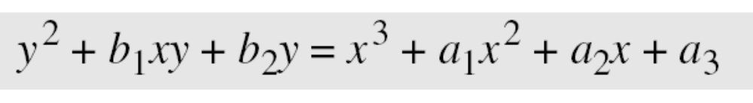
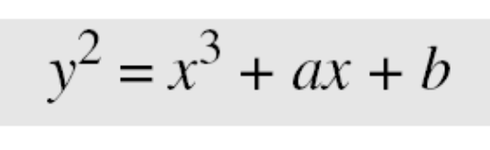
Elliptic Curves over Real Numbers
The general equation for an elliptic curve is
Elliptic curves over real numbers use a special class of elliptic curves of the form
B C Dhara, Dept. of IT, JU

Slide 48
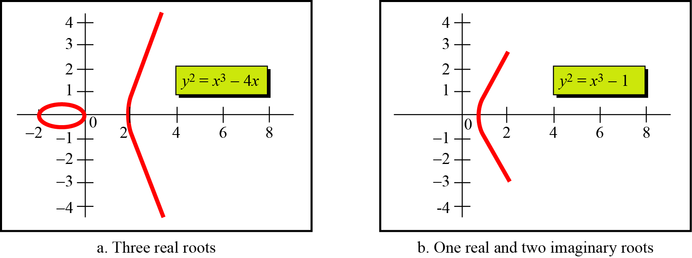
Elliptic Curves over Real Numbers (contd…)
If 4a³+27b² ≠ 0, the equation x³+ax+b=0 has three distinct root
B C Dhara, Dept. of IT, JU

Slide 49
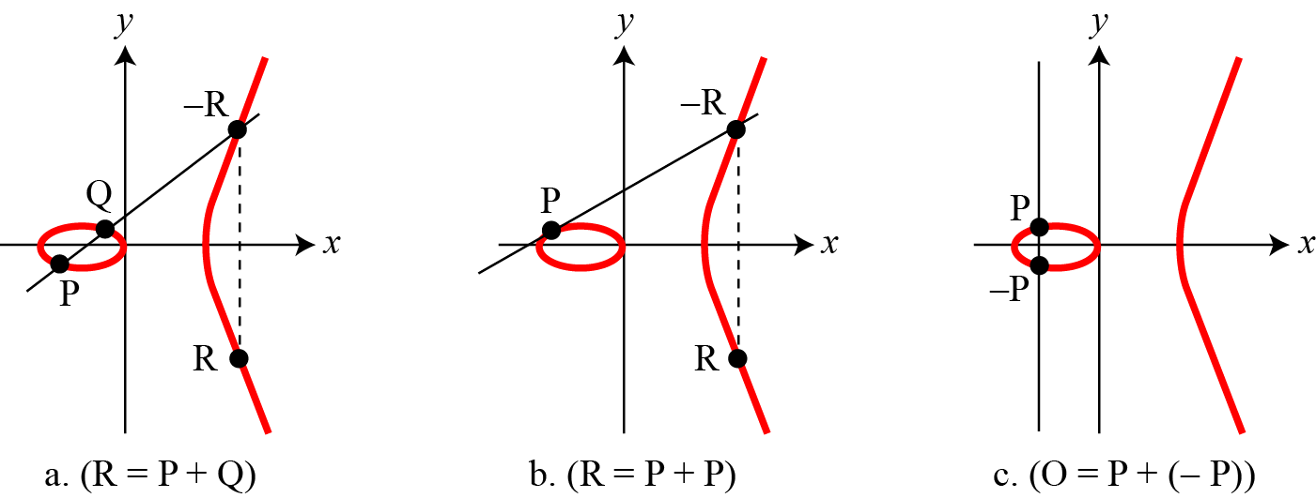
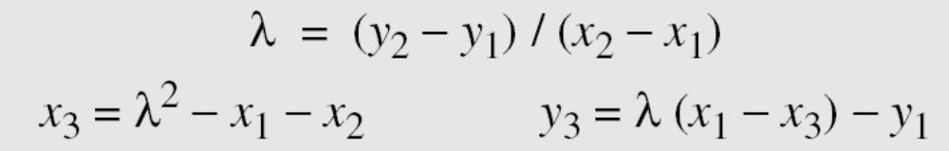
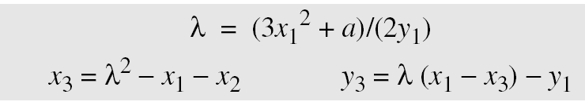
Points on Elliptic curve
Points on Elliptic curve over real numbers forms an Abelian group under addition, where addition is defined as follows:
3. The intercepting point is at infinity; a point O as the point at infinity or zero point, which is the additive identity of the group.
B C Dhara, Dept. of IT, JU

Slide 50
Finding an Inverse in GF(p)
The inverse of a point (x, y) is (x, −y), where −y is the additive inverse of y.
For example, if p = 13, the inverse of (4, 2) is (4, 11).
B C Dhara, Dept. of IT, JU

Slide 51
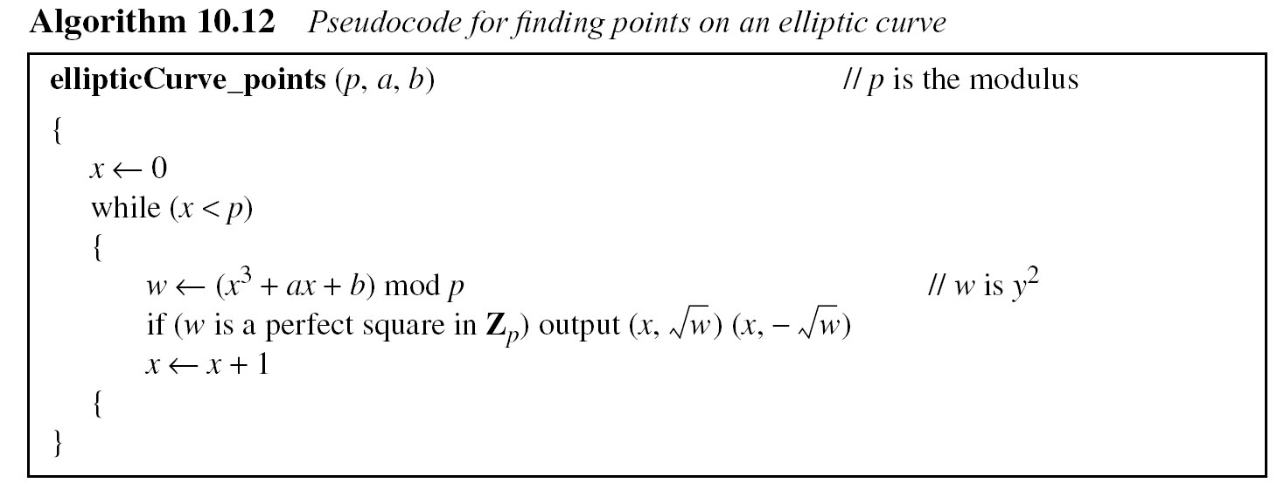
Finding Points on the Curve Ep(a, b) in GF(p)
B C Dhara, Dept. of IT, JU

Slide 52
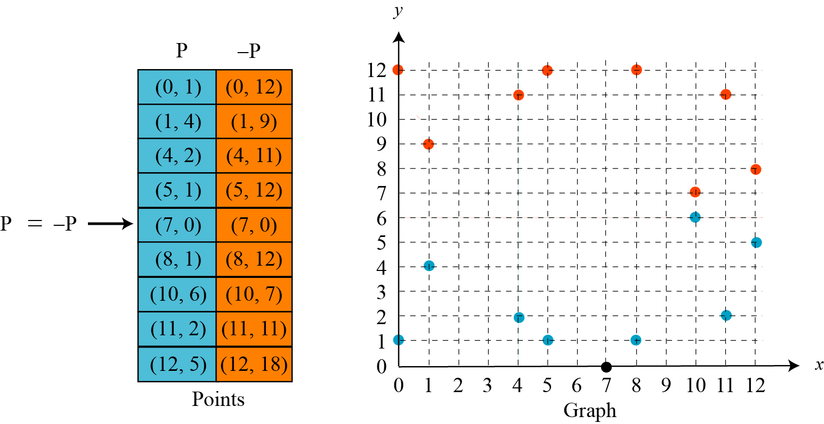
Finding Points on the Curve Ep(a, b) in GF(p)
The equation is y² = x³ + x + 1 and the calculation is done modulo 13
B C Dhara, Dept. of IT, JU

Slide 53
Adding two points in GF(p)
Let us add two points in Example 10.14, R = P + Q, where
P = (4, 2) and Q = (10, 6).
a. λ = (6 − 2) × (10 − 4)⁻¹ mod 13 = 4 × 6⁻¹ mod 13 = 5 mod 13.
b. x = (5² − 4 −10) mod 13 = 11 mod 13.
c. y = [5 (4 −11) − 2] mod 13 = 2 mod 13.
d. R = (11, 2), which is a point on the curve in Example 10.14.
How about E₂₃(1,1), let P=(3, 10) and Q=(9,7): P + Q?; 2P?
B C Dhara, Dept. of IT, JU

Slide 54
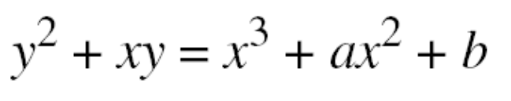
Elliptic Curves over GF(2^{n})
Finding Inverses
If P = (x, y), then −P = (x, x + y).
Finding Points on the Curve
We can write an algorithm to find the points on the curve using generators for polynomials discussed in Chapter 7..
B C Dhara, Dept. of IT, JU

Slide 55
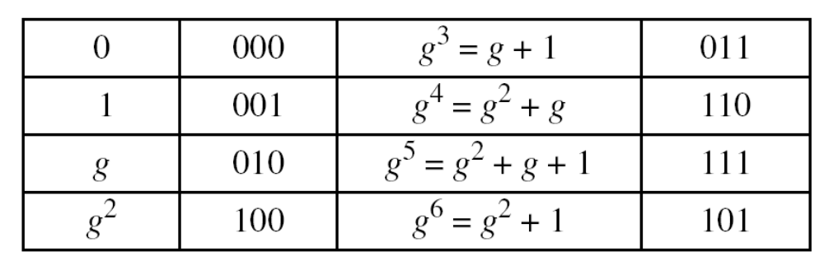
Points on EC in GF(2^{n})
We choose GF(2³) with elements {0, 1, g, g², g³, g⁴, g⁵, g⁶} using the irreducible polynomial of f(x) = x³ + x + 1, which means that
g³ + g + 1 = 0 or g³ = g + 1. Other powers of g can be calculated
accordingly. The following shows the values of the g’s.
B C Dhara, Dept. of IT, JU

Slide 56
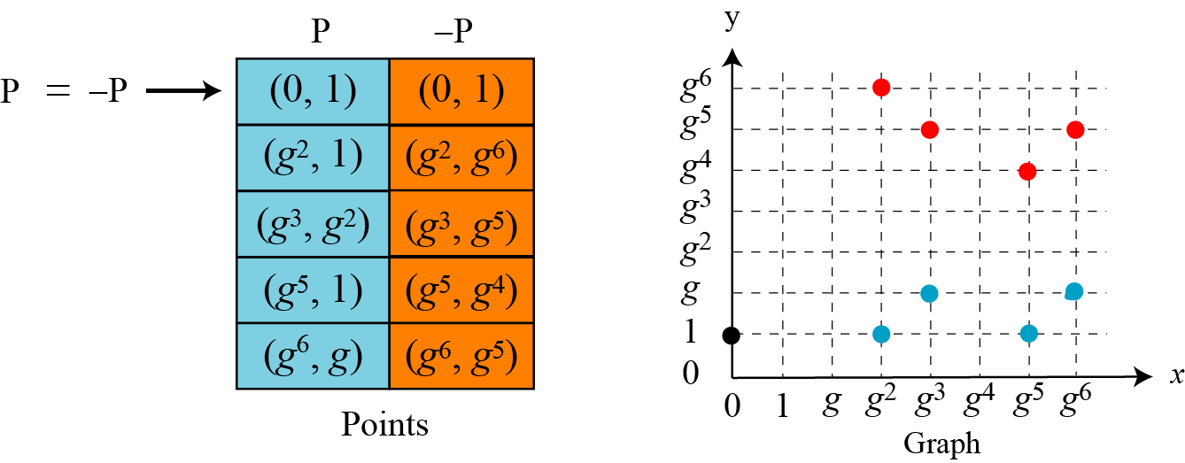
Points on EC in GF(2^{n}) (contd…)
Using the elliptic curve y² + xy = x³ + g³x² + 1, with a = g³ and
b = 1, we can find the points on this curve, as shown in Figure 10.15..
B C Dhara, Dept. of IT, JU

Slide 57
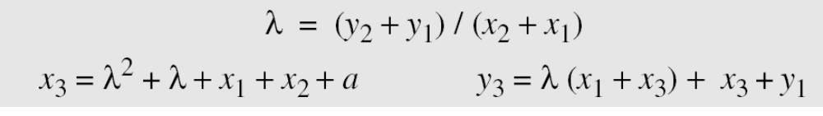
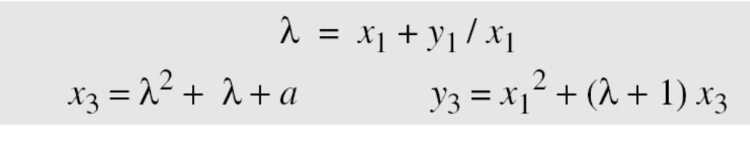
Adding two points on EC in GF(2^{n})
Adding Two Points
1. If P = (x₁, y₁), Q = (x₂, y₂), Q ≠ −P, and Q ≠ P, then R = (x₃, y₃)
= P + Q can be found as
If Q = P, then R = P + P (or R = 2P) can be found as
B C Dhara, Dept. of IT, JU

Slide 58
Adding two points on EC in GF(2^{n}): example
Let us find R = P + Q, where P = (0, 1) and Q = (g², 1).
We have λ = 0 and R = (g⁵, g⁴).
Let us find R = 2P, where P = (g², 1). We have λ = g² + 1/g²
= g² + g⁵ = g + 1 and R = (g⁶, g⁵).
B C Dhara, Dept. of IT, JU

Slide 59
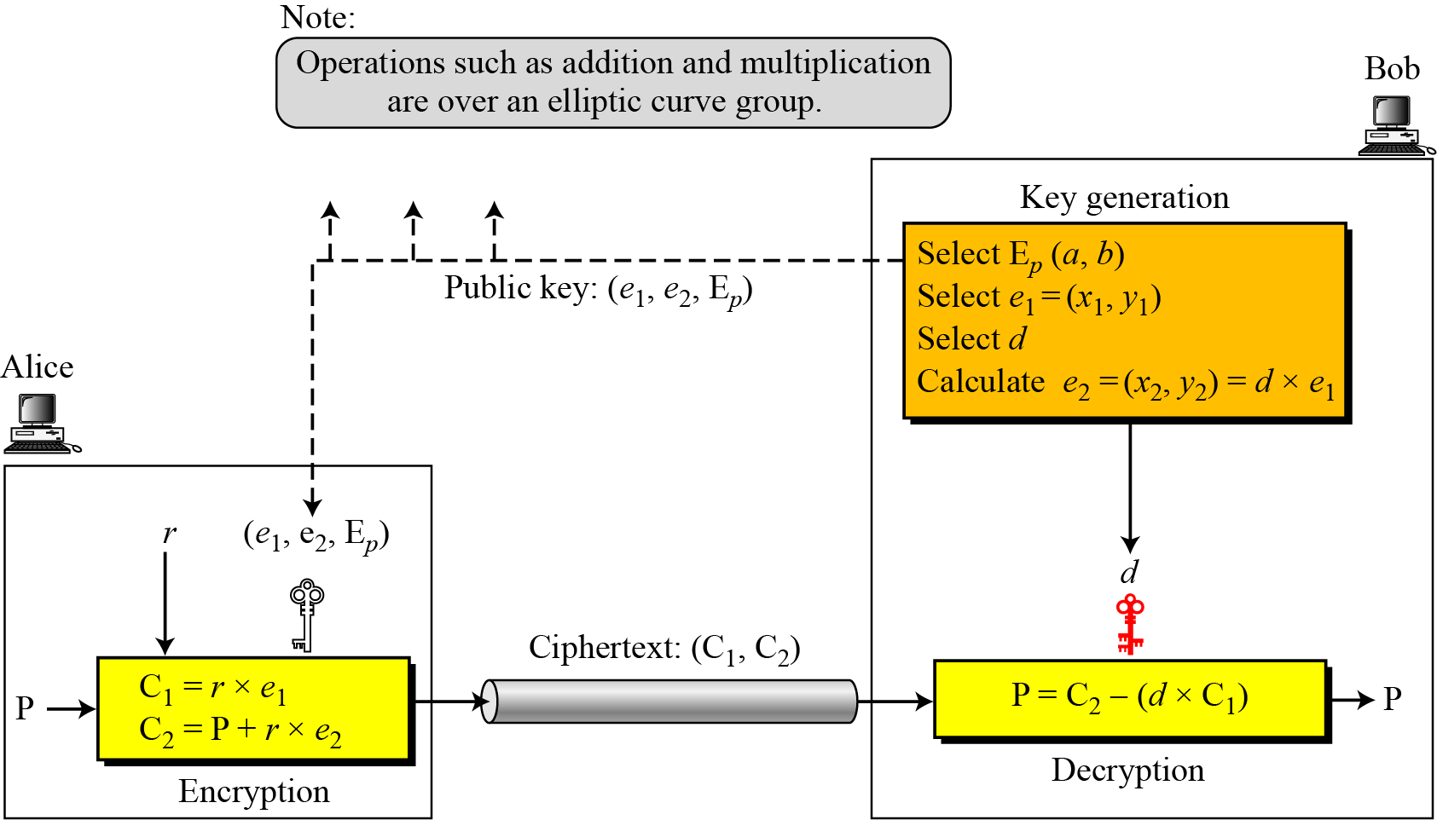
ElGamal cryptosystem using the elliptic curve
The security of ECC depends on the difficulty of solving the elliptic curve logarithm problem.
B C Dhara, Dept. of IT, JU

Slide 60
Example: ECC
Bob selects E₆₇(2, 3) as the elliptic curve over GF(p).
Bob selects e₁ = (2, 22) and d = 4.
Bob calculates e₂ = (13, 45), where e₂ = d × e₁.
Bob publicly announces the tuple (E, e₁, e₂).
Alice sends the plaintext P = (24, 26) to Bob. She selects r = 2.
Alice finds the point C₁=(35, 1), C₂=(21, 44).
Bob receives C₁, C₂. He uses 4xC₁(35,1) to get (23, 25), inverts the points (23, 25) to get the points (23, 42).
Bob adds (23, 42) with C₂=(21, 44) to get the original one P=(24, 26).
B C Dhara, Dept. of IT, JU

Slide 61

Comparable Key Sizes for Equivalent Security
B C Dhara, Dept. of IT, JU

